Slide 1
PSW Member Meet Up!
03/21/23 – PGx Laboratory Testing

Slide 2
Objectives
Review basic DNA considerations pertinent to pharmacogenetics
Explore options for PGx testing: in-house vs external?
Summarize important components for evaluating external testing companies

Slide 3
Recommended Viewing Prior to Meet Up
Online:
Sequencing vs Genotyping (Sanford)

Slide 4
DNA Technology

Slide 5
DNA Technology
Several methods of DNA evaluation, however we will talk about sequencing and probing (‘genotyping’) as general methods of DNA evaluation.
Both involve PCR, but there are many important differences in the primers and probes used, as well as detection and cost considerations
EXCELLENT Video: Sequencing vs Genotyping (Sanford)

Slide 6
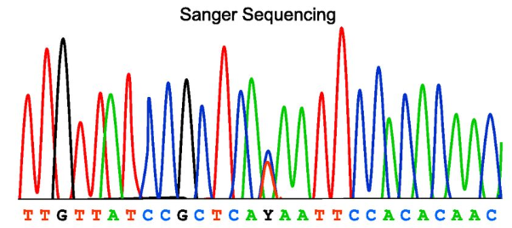
Genetic Testing: Sequencing
Sequencing
You see almost everything
2 strands of DNA:
What we’re seeing here is that the patient is heterozygous at this location, indicating one allele is T and the other allele is C
Images: Johnsen J, Nickerson D, Reiner A. Massively parallel sequencing: the new frontier of hematologic genomics. Blood (2013):122:3268-3275. PMID 24021669

Slide 7
PGx Testing: Sequencing
You identify almost all sequence changes
Captures coding and non-coding sequence (primer directed)
MANY testing options:
Single/Targeted gene analysis
Whole Exome Sequencing (WES)
Whole Genome Sequencing (WGS)
Identifies SNPs as well as small insertions or deletions (= “indels”)

Slide 8
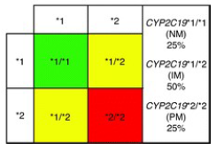
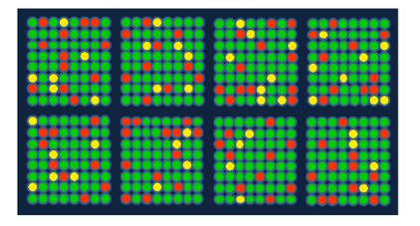
Genetic Testing: Genotyping
Aka probing, targeted variant analysis
You only find what you’re looking for
For Example/Visual Representation:
No variants identified
One copy of variant identified
Two copies of variants identified
Images: Johnsen J, Nickerson D, Reiner A. Massively parallel sequencing: the new frontier of hematologic genomics. Blood (2013):122:3268-3275. PMID 24021669
Zdanowicz MM, American Society of Health-System Pharmacists, eds. Concepts in Pharmacogenomics: Fundamentals and Therapeutic Applications in Personalized Medicine. Second edition. American Society of Health-System Pharmacists; 2017.
Notes:
Verbalize: Note we can only identify a change if we know to look for it in the DNA. Most price-friendly PGx is genotyping, which is usually sufficient for PGx.

Slide 9
PGx Testing: Genotyping (probing)
Usually for identification of SNPs – have to know what you’re looking for
MANY Techniques
Hybridization Techniques (mass arrays, chip technology)
Enzyme-based Techniques
Other Techniques
Can sometimes detect deletions, insertions and duplications

Slide 10
PGx Testing: Genotyping (probing)
Limitations and Considerations
Definition of ‘wild-type’ often is defined as absence of detected variant (probing technology does not GUARANTEE that important changes are found)
Incorrect assignment of genotype and often phenotype as well
Important to know the *1 allele is usually the default unless a variant is found
Genotype sometimes predicted instead of definitively/ quantitatively tested for:
X-linked genes
Hard to distinguish genotypes (e.g., TMPT *1/*3C vs *3A/*3B)

Slide 11
Internal Versus External Testing:

Slide 12
Internal PGx Testing
Pros:
Selection of genes/alleles
Faster Turnaround Time (TAT)
May improve EMR integration abilities
May be able to reduce costs of testing
Cons:
Scale of economy – min. volumes
Billing
Regulation
Staff, space, overhead and other costs
Troubleshooting

Slide 13
External PGx Testing
Pros:
Often offer variable billing options and price ranges
Patient and provider support services
Variety of options
Cons:
Panel selection
Report formatting static
Limited integration options

Slide 14
Evaluating External Laboratories: Costs, Considerations/Regulations & Selection

Slide 15
PGx Laboratory Testing: Estimated Costs of Tech
Sequencing more expensive –
Single/Targeted Gene Analysis: ~$200-$400
Whole exome: ~$350-$1150
Whole genome: ~$1500-$5400
Note: Read depth will influence cost (positive correlation)
Genotyping (probing) cheaper –
Costs usually range in the $200-$400 range for >20 genes
Sometimes able to detect Copy Number Variations (e.g., CYP2D6*1xN)
These are estimates as of 2019/2020; in general, the cost of this type of testing is decreasing with time.
WES cost reference: https://www.abmgood.com/Exome-Sequencing-Service.html
WGS cost reference: https://www.abmgood.com/Whole-Genome-Sequencing-Service.html

Slide 16
Laboratory Considerations/Regulations
If results to be used clinically, the lab must be CLIA certified, CAP accreditation is also preferred
Clinical Laboratory Improvement Amendments (1988)
Goal: to ensure quality laboratory testing
Annual competencies for technologists and assay
Required for reimbursement from Centers for Medicare and Medicaid Services (CMS)
Regulated by the FDA, CMS and CDC
College of American Pathologists (CAP) Accreditation
Builds upon CLIA regulations
Granted ‘deeming’ (granting) authority by CMS as well as the Joint Commission
CLIA Law & Regulations: https://www.fda.gov/medical-devices/ivd-regulatory-assistance/clinical-laboratory-improvement-amendments-clia ; https://www.cms.gov/regulations-and-guidance/legislation/clia/index.html
; https://www.cdc.gov/clia/law-regulations.html
Notes:
https://www.fda.gov/medical-devices/ivd-regulatory-assistance/clinical-laboratory-improvement-amendments-clia
https://www.cms.gov/regulations-and-guidance/legislation/clia/index.html

Slide 17
Lab versus Test Requirements
The Clinical Laboratory Improvement Amendments (CLIA) program regulates laboratories
The FDA regulates…devices [like LDTs]…to ensure that devices…are reasonably safe and effective
When a laboratory develops a test system such as an LDT in-house without receiving FDA clearance or approval, CLIA prohibits the release of any test results prior to the laboratory establishing certain performance characteristics relating to analytical validity for the use of that test system in the laboratory’s own environment…
This analytical validation is limited, however, to the specific conditions, staff, equipment and patient population of the particular laboratory…
LDT and CLIA FAQs (https://www.cms.gov/regulations-and-guidance/legislation/clia/downloads/ldt-and-clia_faqs.pdf )

Slide 18
Lab versus Test Requirements
Although the [FDA] requires manufacturers of all in vitro diagnostic devices (IVDs), including LDTs, to comply with the regulatory requirements governing device safety and effectiveness (such as quality controls for device design and other aspects of device manufacturing, premarket clearance/approval, etc.), the FDA has exercised enforcement discretion so that the agency has generally not enforced these requirements for LDTs.
FDA premarket review assures both the analytical validity (e.g. analytical specificity and sensitivity, accuracy and precision) and clinical validity of IVDs.
LDTs, generally have not undergone FDA premarket review but may be considered clinically valid if thoroughly validated in accordance with CLIA requirements of the lab
LDT and CLIA FAQs (https://www.cms.gov/regulations-and-guidance/legislation/clia/downloads/ldt-and-clia_faqs.pdf )

Slide 19
Lab versus Test Requirements: “TL;DR” Version
CLIA regulates laboratories
LDTs are regulated by the FDA **BUT** the CLIA requirements of the lab require that the lab demonstrates analytical validity within that lab
LDTs (and thus a LOT of commercial PGx testing) is NOT technically FDA approved BUT may be validated for clinical testing under LDT FDA regulation (when enforced) and CLIA laboratory regulations.
LDT and CLIA FAQs (https://www.cms.gov/regulations-and-guidance/legislation/clia/downloads/ldt-and-clia_faqs.pdf )

Slide 20
Laboratory Selection
EXCELLENT article by Vo et al (2017): “Pharmacogenomics Implementation: Considerations for Selecting a Reference Laboratory.”
Key Questions to Answer Before Choosing Your Testing Lab
4 “Domains” of Considerations
PharmacoGene selection
Patient sampling (Logistics)
Results Reporting
Billing/Cost (Testing cost and Reimbursement)
Vo TT, Bell GC, Owusu Obeng A, Hicks JK, Dunnenberger HM. Pharmacogenomics Implementation: Considerations for Selecting a Reference Laboratory. Pharmacotherapy. 2017 Sep;37(9):1014-1022. doi: 10.1002/phar.1985. Epub 2017 Sep 3. PMID: 28699700.

Slide 21
Laboratory Selection
PharmacoGene Selection
More is not better
Many tested genes are informative (not actionable)
Evidence-based, actionable genes
See CPIC guidelines
No guideline, not in Prescribing Information = not actionable
Patient Sampling (Logistics)
Most PGx testing is non-invasive: buccal swab or saliva
Who is collecting the sample?
Patient vs Provider (additional costs if Provider Office?)
Vo et al. Pharmacotherapy. 2017:37(9):1014-1022. PMID: 28699700

Slide 22
Laboratory Selection
Results Reporting
Formatting of report
User friendliness
The ‘details’
Genes tested, limitations, etc.
Billing/Costs
Who is paying for the testing?
Direct patient pay versus billing insurance
Most insurances DO NOT cover testing at this time
Vo et al. Pharmacotherapy. 2017:37(9):1014-1022. PMID: 28699700

Slide 23
Laboratory Selection
Additional Considerations: Know the limitations of your assay
In house vs send out (Turn-Around Time)
Sequencing vs genotyping
What alleles are queried and which are not
For example: CYP2C19
*17 allele = increased transcription → increased activity
*4 allele = *17 + inactivating SNP → no activity
If both not part of panel, can have incorrect phenotype assignment
Is ethnicity taken into account?
Do the variants they test for cover your patient population well?
Might change interpretation of results
Will quality of sample be communicated if suboptimal?
What do they do with samples after testing?
Validation? Research? Discard?
Notes:
https://www.fda.gov/medical-devices/ivd-regulatory-assistance/clinical-laboratory-improvement-amendments-clia
https://www.cms.gov/regulations-and-guidance/legislation/clia/index.html

Slide 24
PGx Laboratory Potpourri
Various Pertinent Topics

Slide 25
Hot Topic: FDA PGx Testing Warnings
In 2018 and 2019 the FDA issued several warning letters to PGx testing companies calling for ceasing of interpretation of results/providing medication recommendations, citing a lack of evidence establishing a function-response relationship of a number of drug-gene pairs.
This caused most PGx testing companies to remove drug recommendations from their reports, leaving only the genetic results and phenotype.
In 2021, some companies started adding the drug recommendations back…
FDA Safety Communication of Genetic Tests with Unapproved Claims. Accessed on 05/05/2020 at https://www.fda.gov/medical-devices/safety-communications/fda-warns-against-use-many-genetic-tests-unapproved-claims-predict-patient-response-specific
FDA Warning Letter to Inova Genomics Laboratory. Accessed on 05/05/2020 at https://www.fda.gov/inspections-compliance-enforcement-and-criminal-investigations/warning-letters/inova-genomics-laboratory-577422-04042019

Slide 26
Anatomy of a PGx Report
See example PGx Test Reports
Usually include
Patient information
A legend/key for the report
Genotype/Phenotype results
Sometimes medication recommendations
Laboratory methodologies, credentials and references

Slide 27
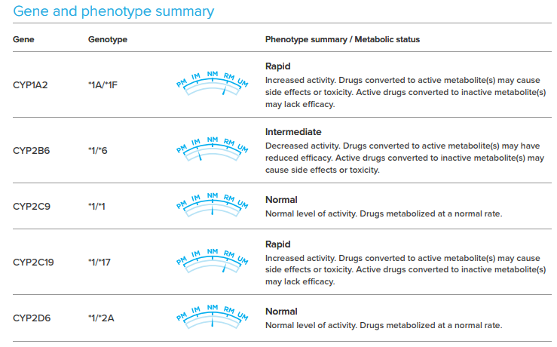
Results Reporting – Example 1 Report

Slide 28
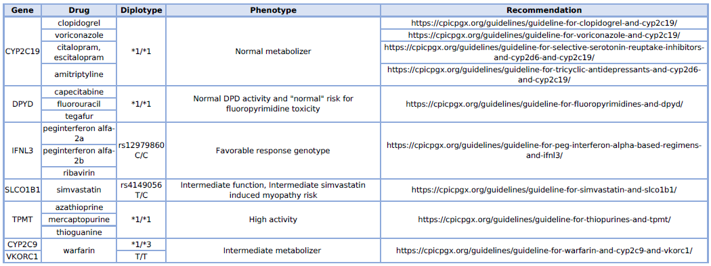
Results Reporting – Example 2 Report

Slide 29
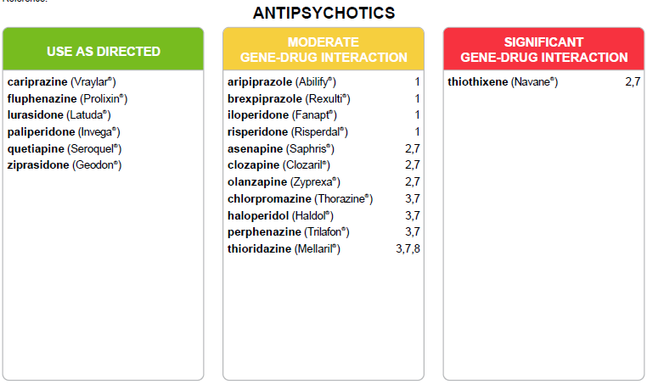
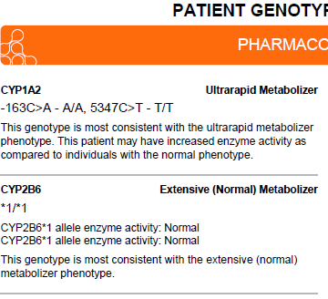
Results Reporting – Example 3 Report

Slide 30
A quick detour – PGx Testing Company, Institution Considerations that affect patient cost of testing
Companies often capitate costs for patients through an assistance program
Some offer direct patient pay for a set amount
You need to be super familiar with the billing process of the Company – AND– your institution
Provider Based Billing may change how you have to bill AND what the patient pays!!!

Slide 31
Provider Based Billing
Definition: “Provider-based billing is a type of billing for services rendered in a hospital outpatient department including a medical office. This billing model also is known as hospital outpatient billing. ”
Why: Better reimbursement for MCHS; “Patients benefit because all hospital outpatient departments are subject to additional stringent quality standards and are monitored by The Joint Commission”
Take Away: At PBB locations (basically any clinic with a hospital on the same campus), if a provider orders testing, then that testing MUST be billed as institutional billing (at the contracted price with vendor plus an internal markup), and the patient is no longer eligible for direct patient pay or the patient assistance program.
The CMS DOS Policy - 14-Day Exception Rule may apply to PGx testing…TBD

Slide 32
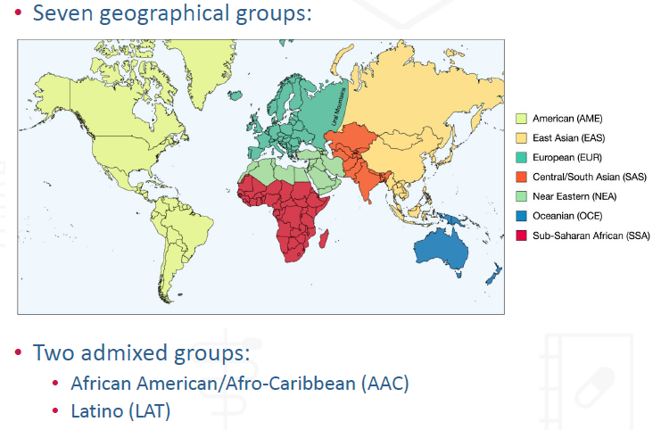
TD Summary Slides: Huddart (2018) - Ancestry
PMID 30506572
Notes:
Admixed groups not shown on map
Note – due to the large geographical areas covered by each group, a single group does not accurately represent the large amount of genetic diversity found in one region

Slide 33
Ancestry Matters
Not only is it critical to include ancestrally diverse populations, but you must also account for pertinent variants in those populations
Some trials have come to incomplete conclusions due to lack of inclusion of pertinent ancestry
Implementers need to be aware of common alleles for their patient population and be able to tell if a testing company tests for those alleles
Testing companies often request [ancestry] as “Ethnicity can influence allele calls and resulting diplotypes when there is ambiguity (i.e., combinations of alleles may be associated with more than one haplotype). The final call is typically based on ethnicity allele frequency”
Notes:
COAG trial

Slide 34
Thank You! What Questions Do You Have?

